Slide 1
Flood Detection In Bangladesh
BY:
Shubham Mishra , Sohail Shaik

Slide 2
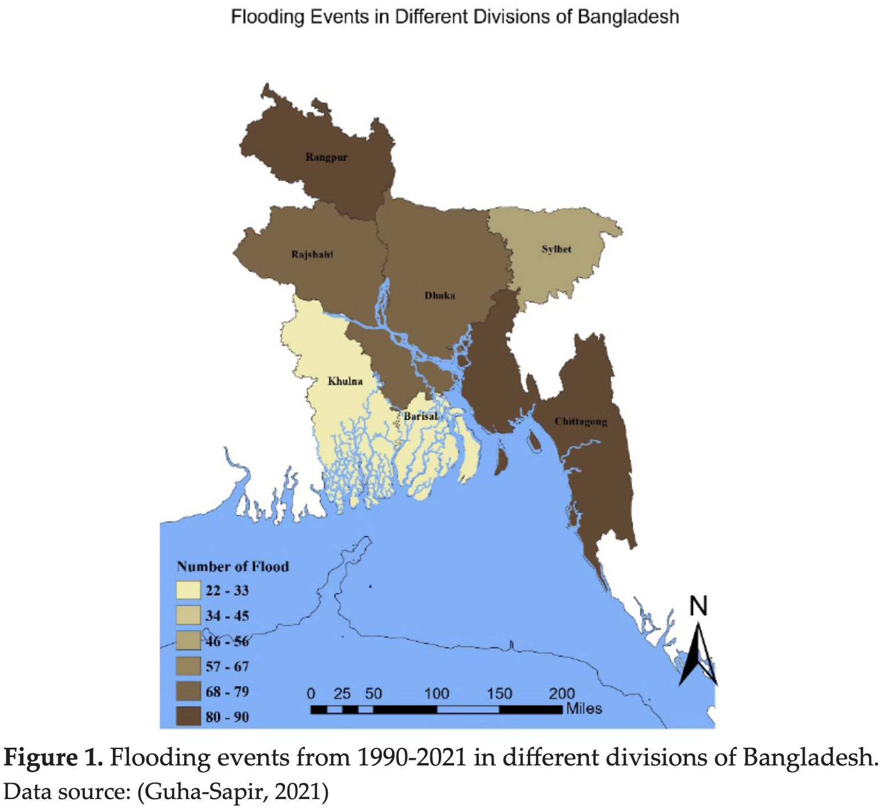
Motivation
In the whole world, Bangladesh is the second country with the highest flood risk of 57.5 percent coming in just after Netherlands. [2]
total population of people exposed = 94,424,000.
Located in the delta of a few major rivers causing seasonal flooding and flash floods that occur without warning causing massive damage quickly. [1]
=> Hence in this data science project, we will be focusing on how to use flood detection systems more systematically in Bangladesh and set up a robust precautionary system in place for the large affected population.
The novelty in our data science project would be that we would provide the people the warning and what all steps they need to take to stay away from the harmful side effects from intense floods in Bangladesh.
https://www.researchgate.net/publication/361890552_FLOOD_RESEARCH_IN_BANGLADESH_AND_FUTURE_DIRECTION_AN_INSIGHT_FROM_LAST_THREE_DECADES

Slide 3
Who will benefit from this solution?
As real-time data and highly reliable equipment will be used, these groups will benefit:
The Public (reduced loss of life).
The government will also benefit from it because of the money saved from providing shelter to the public.
The Country’s economy; Strong economy because flood won’t affect the economy anymore.
The environment; less energy will be used to power these flood detection systems as they can be powered by renewable energy sources like solar energy and wind energy.

Slide 4
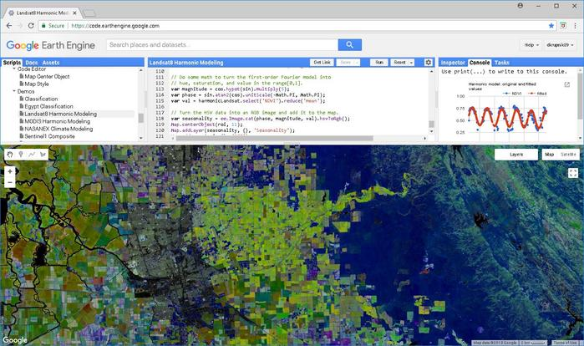
What can be a Solution
Forecast floods with a linear regression model and a warning threshold
Model will predict floods trained with historical data [3] and utilize Google Earth Engine real-time precipitation data [5]
Locate the flood affected areas
Warn the affected population in a timely manner
Notes:
Machine learning Model with linear regression and a warning threshold to forecast a flood and give accurate and timely warning to the citizens in the affected region.
The model will be trained with historical data so that it can predict floods and be utilized with real-time data provided by the Google Earth weather forecasting system. Working in tandem with the data provided for proper forecasting.

Slide 5
What data we will use
Radiant MLHub’s C2S-MS Floods Dataset [3]
Uses labeled Sentinel-1 & Sentinel-2 pairs
18 global flood events
Bangladesh’s real-time flood monitoring data [4]
Monsoon Period - June to September
Perception tracking from Earth Engine (GSMap Operational) [5]
Notes:
https://public.wmo.int/en/resources/bulletin/flood-forecasting-and-warning-bangladesh
https://mlhub.earth/data/c2smsfloods_v1

Slide 6
References
[1] “Rising Flood Risks in Bangladesh,” earthobservatory.nasa.gov, Aug. 31, 2022. https://earthobservatory.nasa.gov/images/150274/rising-flood-risks-in-bangladesh
[2] N. Conte, “Mapped: Countries With the Highest Flood Risk,” Visual Capitalist, Sep. 14, 2022. https://www.visualcapitalist.com/countries-highest-flood-risk/
[3] “NASA Flood Extent Detection,” mlhub.earth. https://mlhub.earth/data/ (accessed Jan. 28, 2023).
[4] “Flood Forecasting and Warning in Bangladesh,” World Meteorological Organization, Mar. 22, 2018. https://public.wmo.int/en/resources/bulletin/flood-forecasting-and-warning-bangladesh
[5] “GSMaP Operational: Global Satellite Mapping of Precipitation | Earth Engine Data Catalog,” Google Developers. https://developers.google.com/earth-engine/datasets/catalog/JAXA_GPM_L3_GSMaP_v6_operational#description (accessed Jan. 29, 2023)

